Slide 1
Effect of Management Practices on Animal Welfare and Economic Outcomes for Beef Cattle Statistical Analysis
Danielle Contreras
Dr. Ann Hess
Melissa Davis
Dr. Lily Edwards-Callaway

Slide 2
Study Design
501 Lots of cattle
71,053 Cattle
Observational Study
4 different companies(Tyson, JBS, Cargill, and Harris Ranch)
8 Different States(Colorado, Wyoming, North Dakota, South Dakota, Nebraska, Texas, Kansas, Oklahoma)
4 Plants
Data was collected from March 2021 to April 2022.
Multiple people collected the data

Slide 3
Variables
Welfare Outcome: Limp(Mobility)
Quality Outcome: Hot Weight(Yield)
Predictors (Pre-Slaughter Management): Sex, Plant, Kill Shift, Arrival to Unload Time, Arrival Temperature, Arrival Humidity, Pen Density
Additional predictors and outcomes were collected, but were not used in analysis

Slide 4
Research Questions
What is the relationship between preslaughter management and welfare outcomes(Limp) at commercial cattle slaughter facilities in the US?(Did the animal have any level of limping?)
What is the relationship between preslaughter management and quality outcomes(Hot Weight) at commercial cattle slaughter facilities in the US?

Slide 5
Challenges
Our main challenge was data wrangling. These were some of the challenges that came along with data wrangling
Lot is the unit of interest. But observational units varied (multiple trucks, pens, etc per lot) depending on variable.
Lot Number was distinguished based on Lot, Arrival and Kill Date, Plant, and Company
Multiple Spreadsheets in Excel, so we had to merge our data together
Format of times and dates in R
Since multiple people collected the data, the formatting in R was not consistent.
Inconsistencies in data entry(Male, Steer, steers)
Missing Data from original entry
Missing Data after merging, 437 Lots with only 144 with complete data

Slide 6


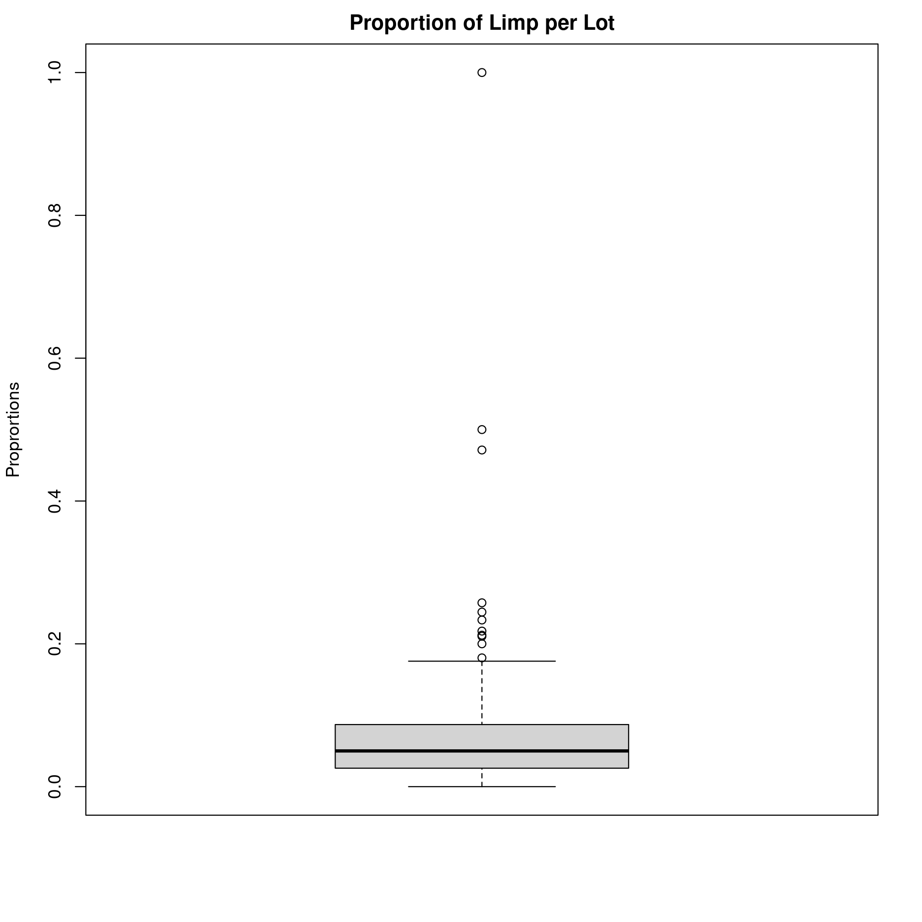
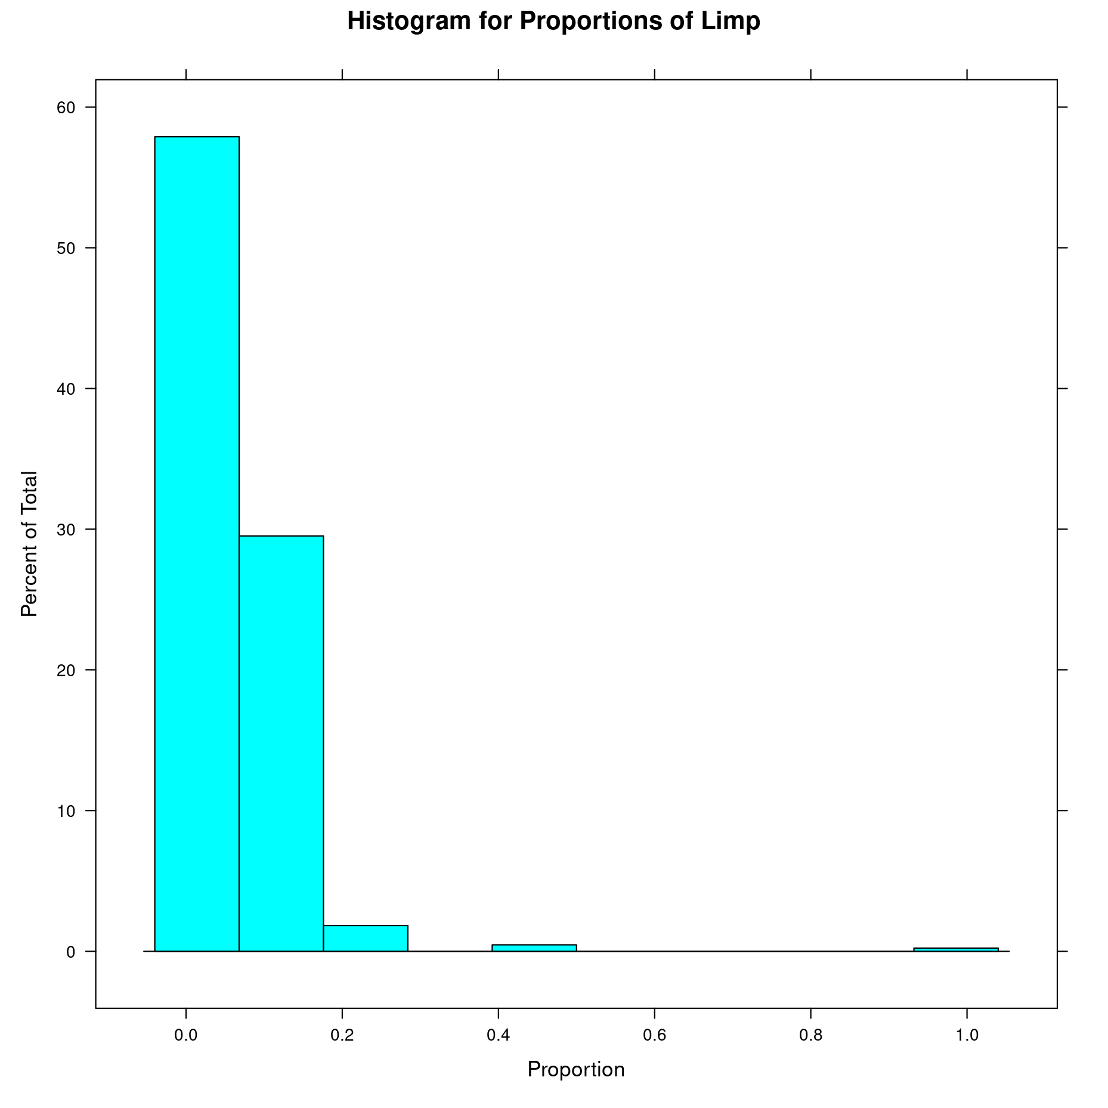

Mobility Summary Statistics (Proportion of Limp)
Sample Size without NA: 393
Min: 0
Max: 1(all animals in lot had limp)
Median: 0.05
Mean: 0.064
Standard Deviation: 0.073
Variance: 0.0053
1st Quartile: 0.025
3rd Quartile: 0.087

Slide 7
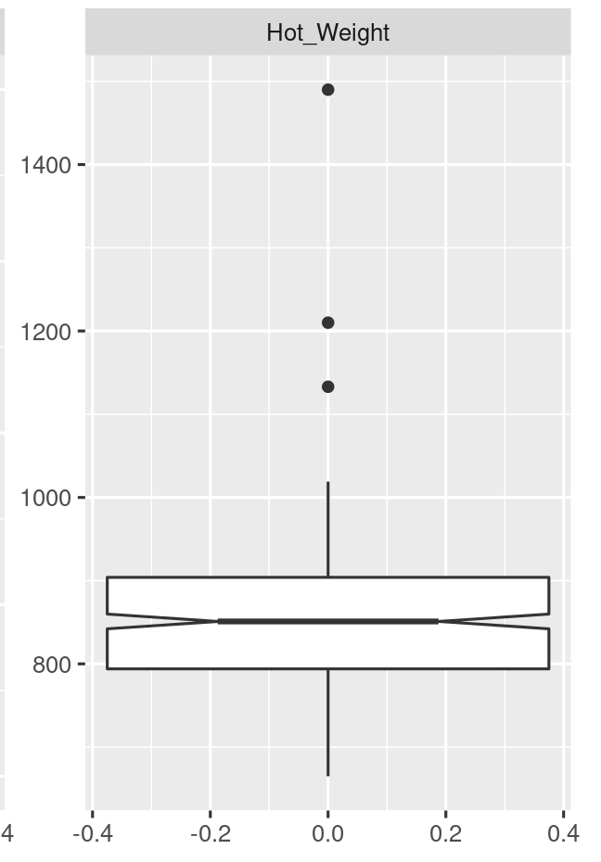
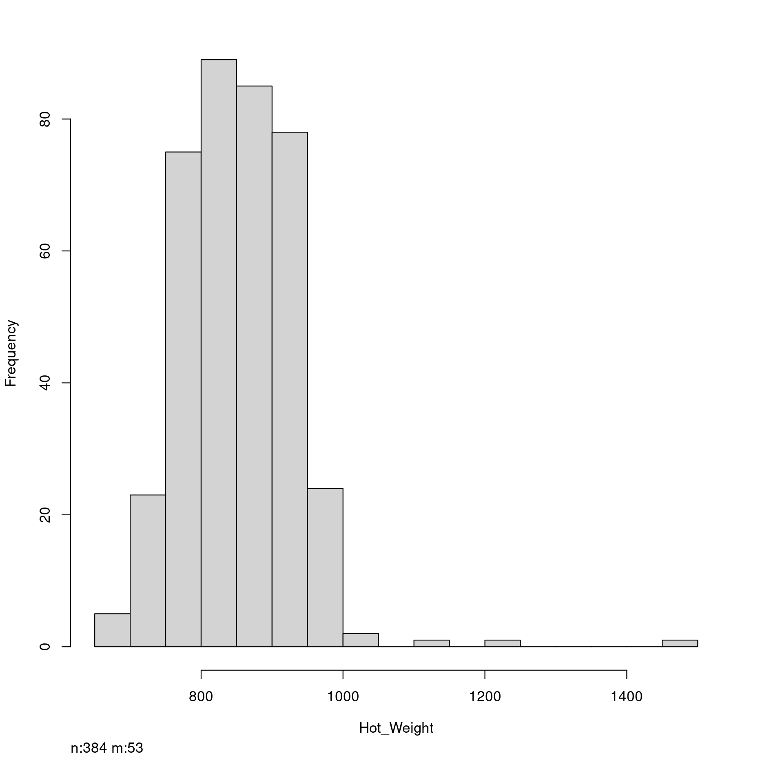
Hot Weight Summary Statistics
Sample Size without NA: 384
Min: 665 lbs
Max: 1490 lbs
Median: 851 lbs
Mean: 853.35 lbs
Standard Deviation: 79.79
Variance: 6365.06
1st Quartile: 794 lbs
3rd Quartile: 904 lbs

Slide 8
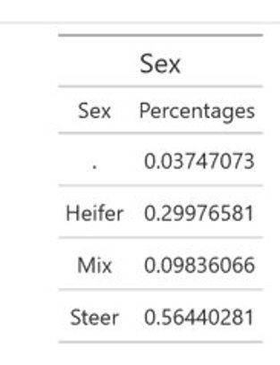
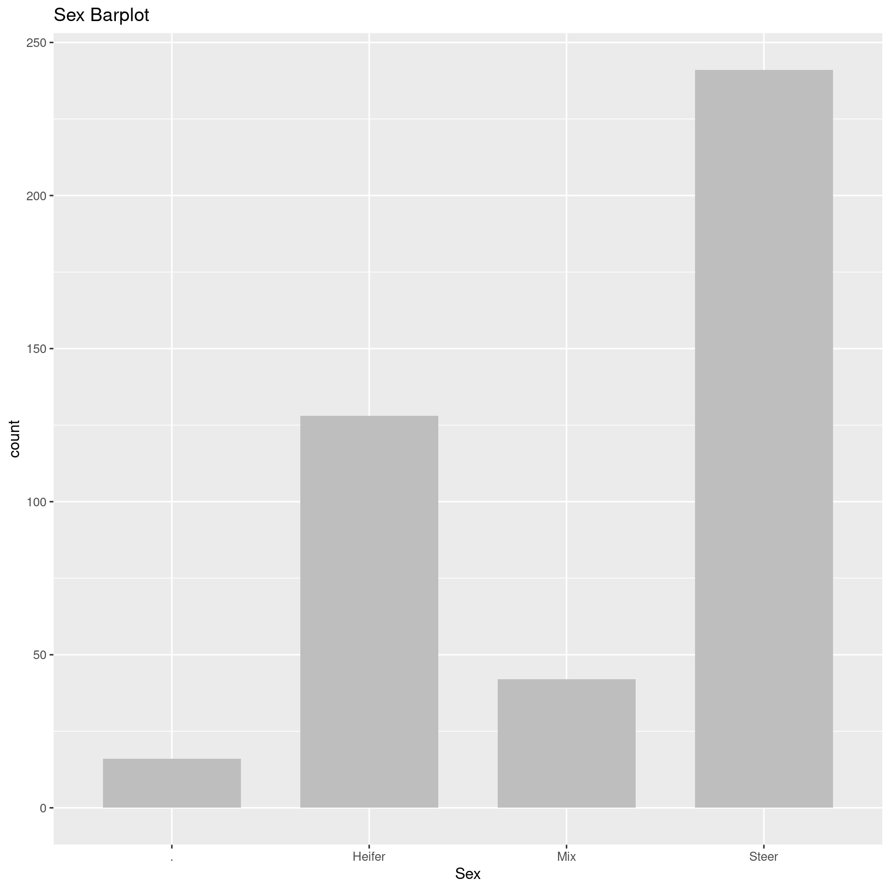
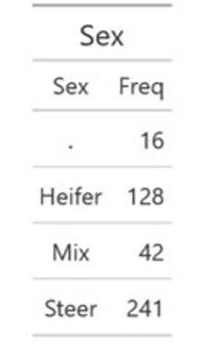
Sex Summary Statistics

Slide 9
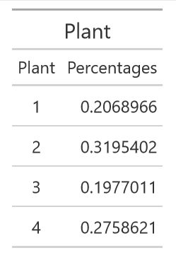
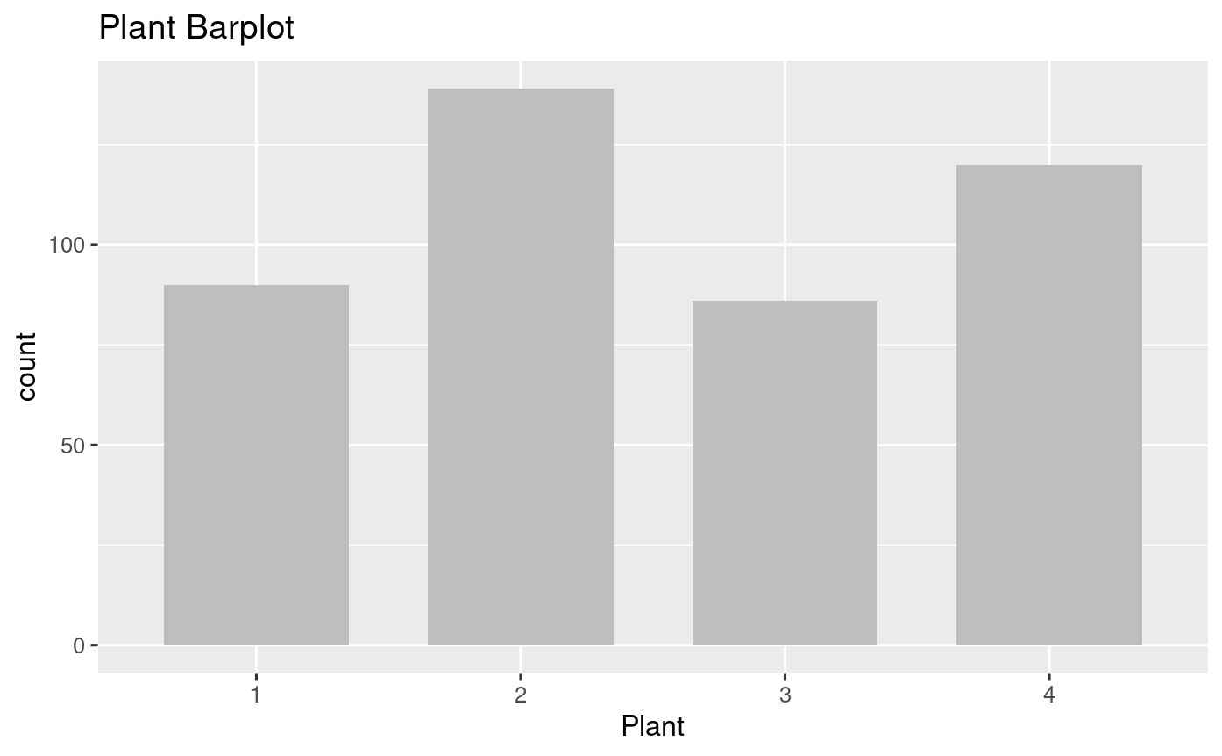
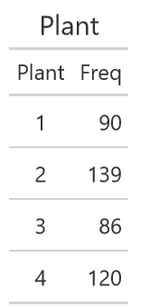
Plant Summary Statistics

Slide 10
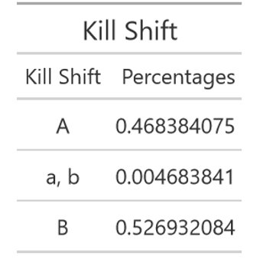
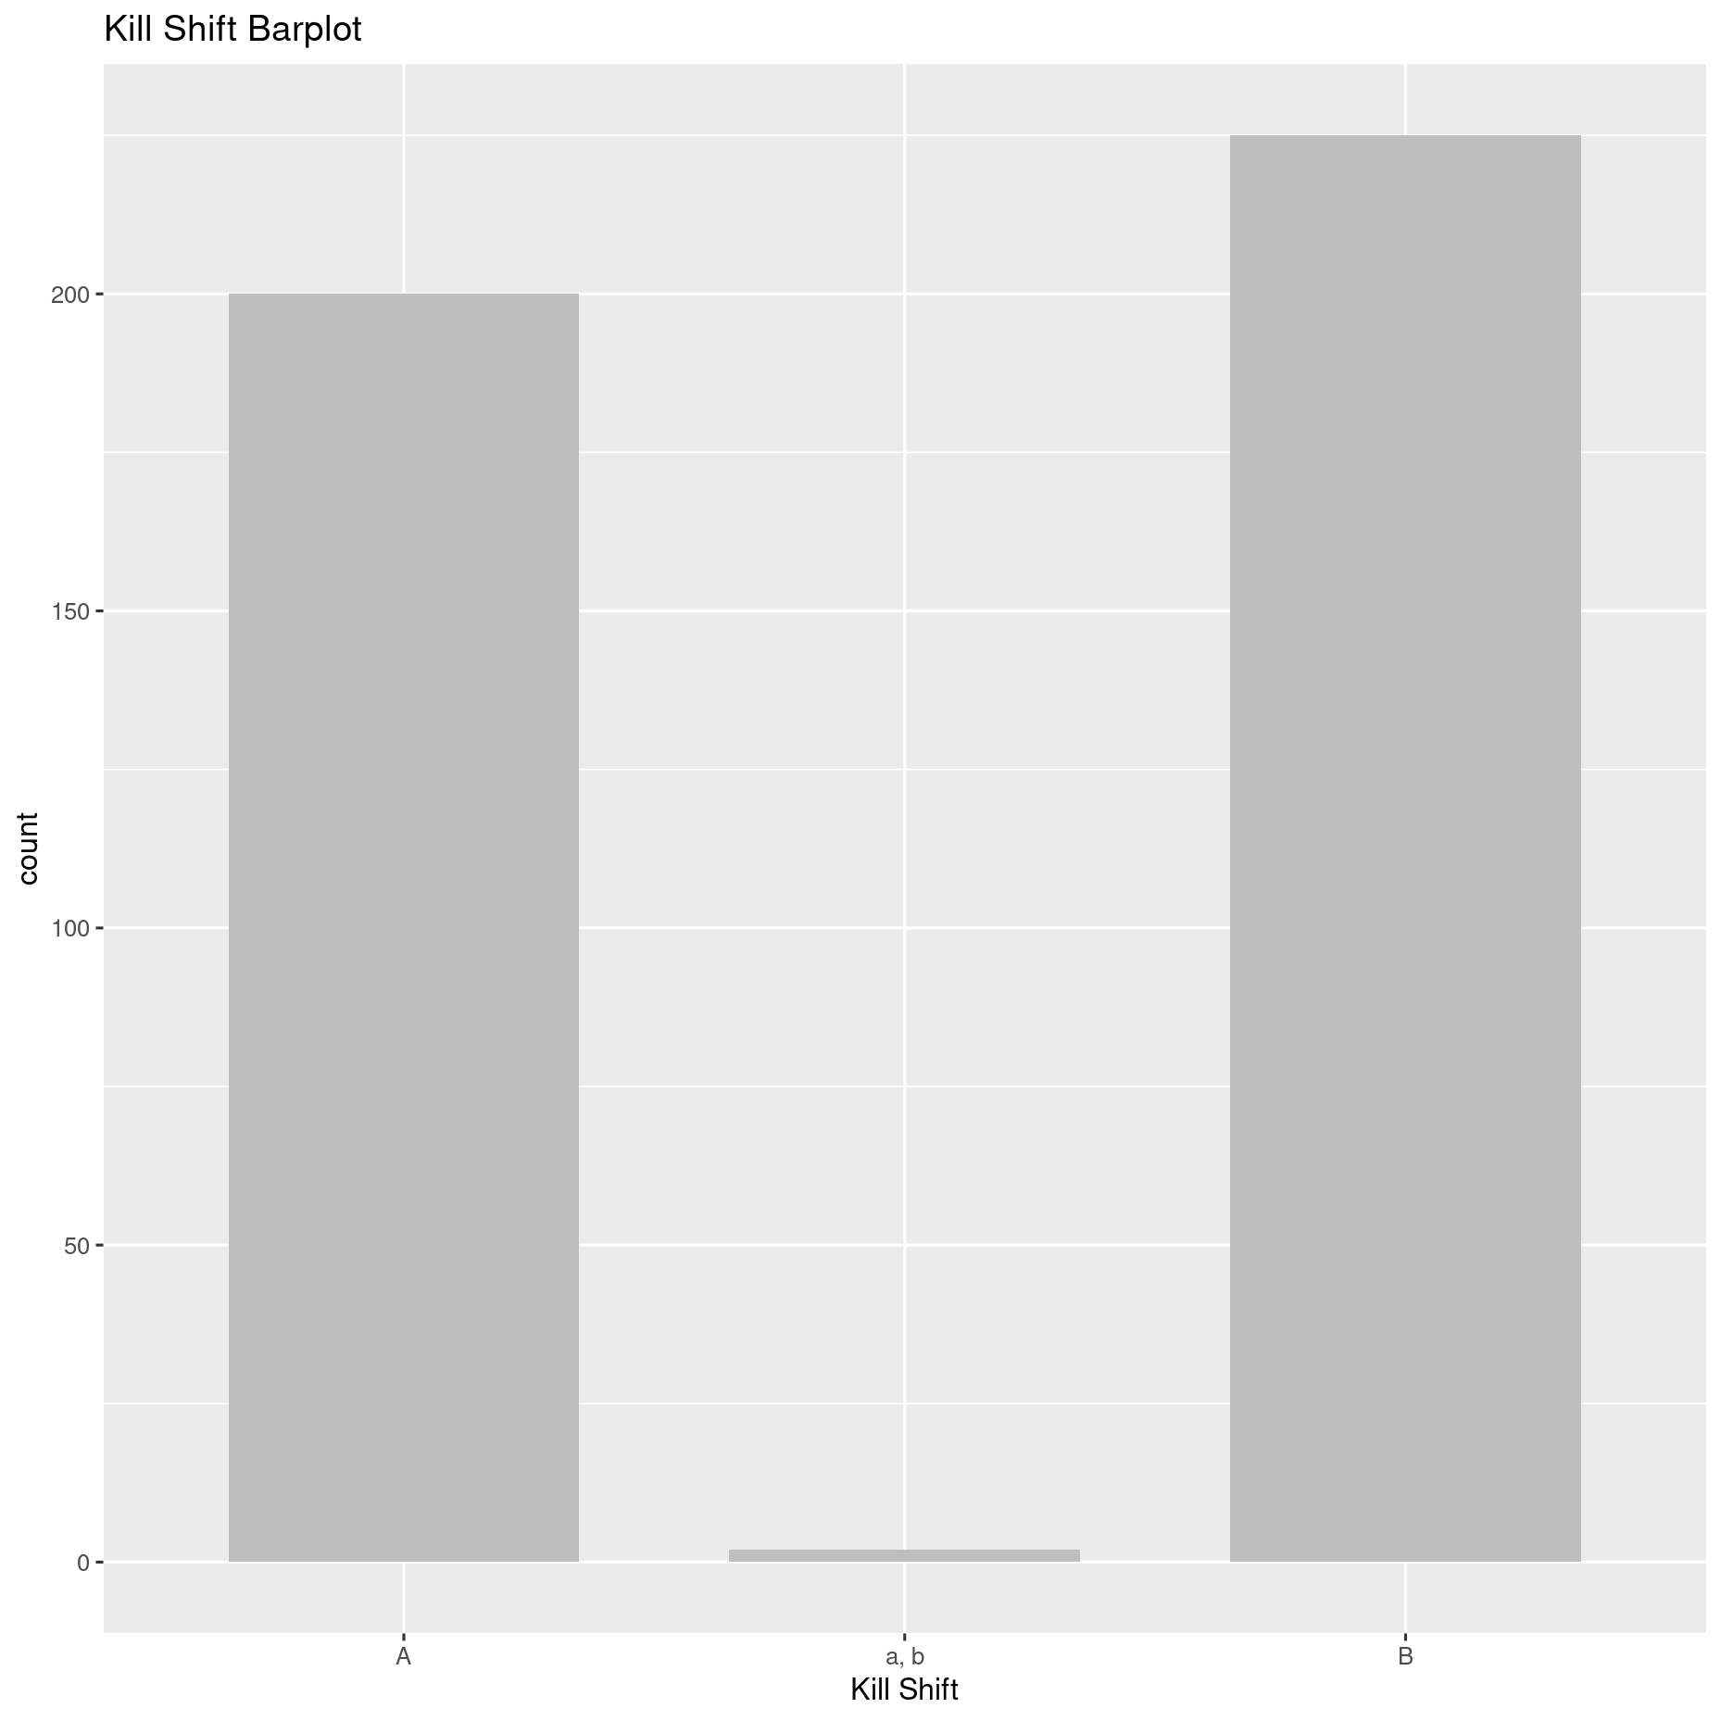
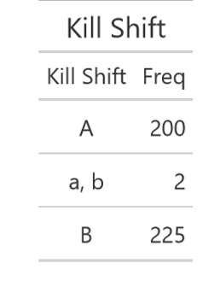
Kill Shift Summary Statistics

Slide 11
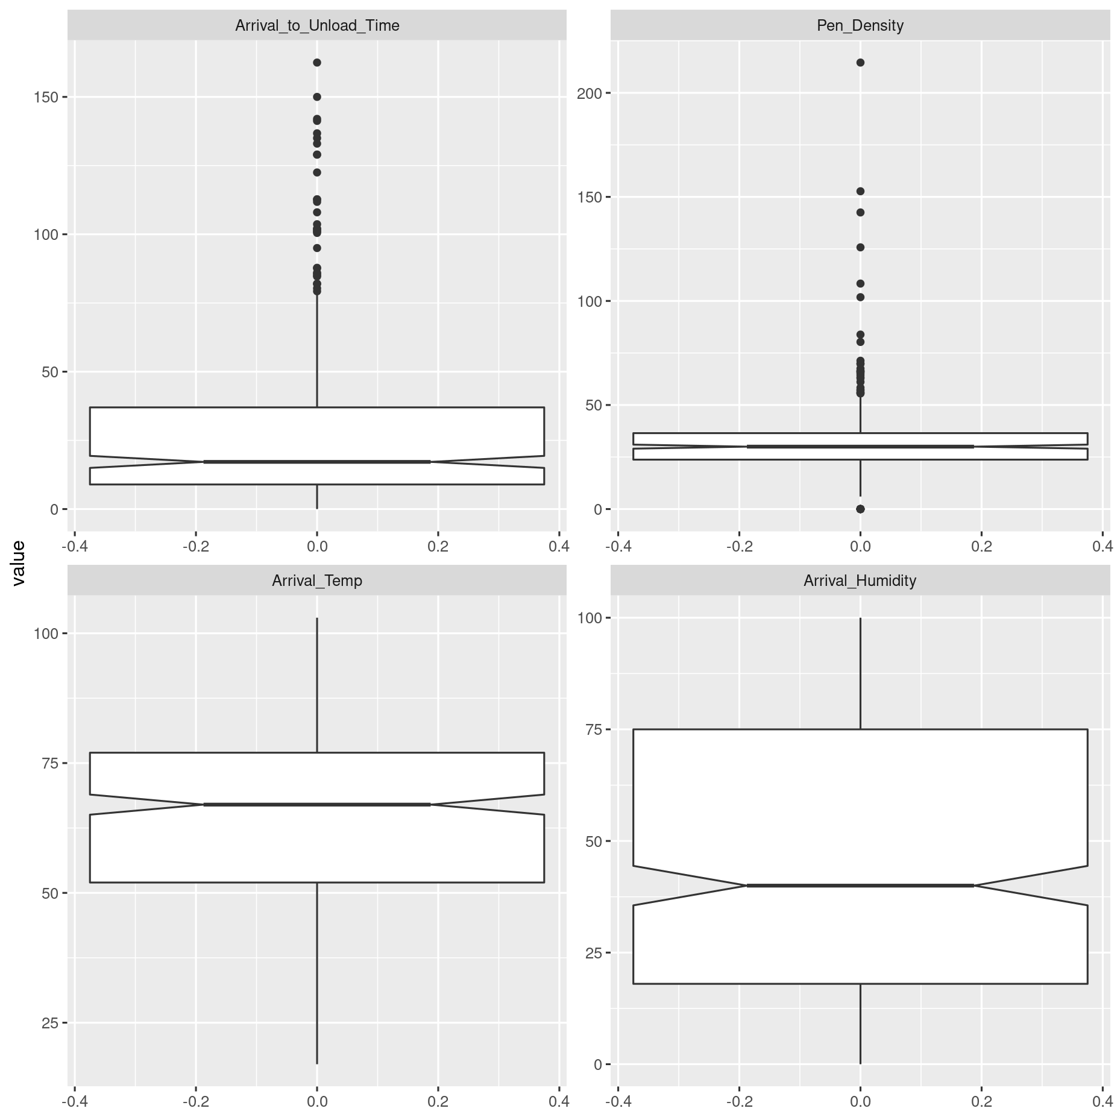
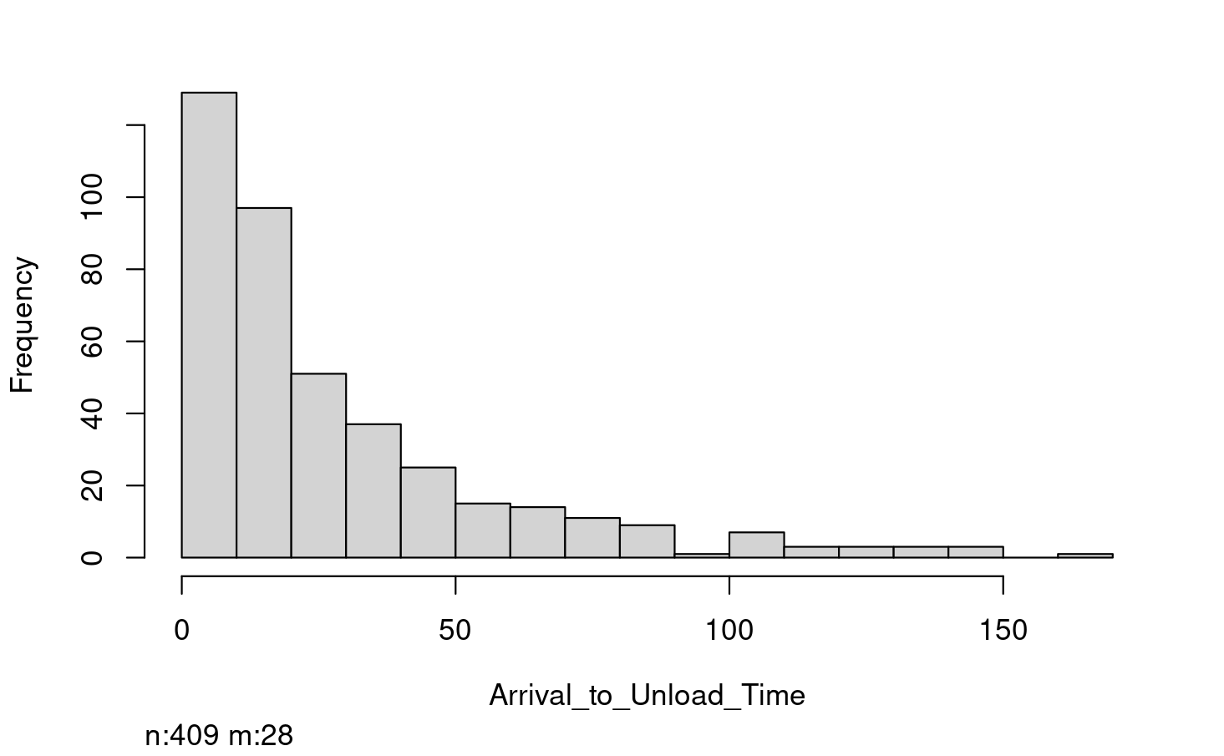
Arrival to Unload Time Summary Statistics
Arrival To Unload Time
Sample Size without NA: 409
Min = 0 Minutes
Max = 162.5Minutes
Median = 17.17 Minutes
Mean = 28.73 Minutes
Standard Deviation = 29.71
Variance = 882.93
1st Quartile = 8.94 Minutes
3rd Quartile = 37 Minutes

Slide 12
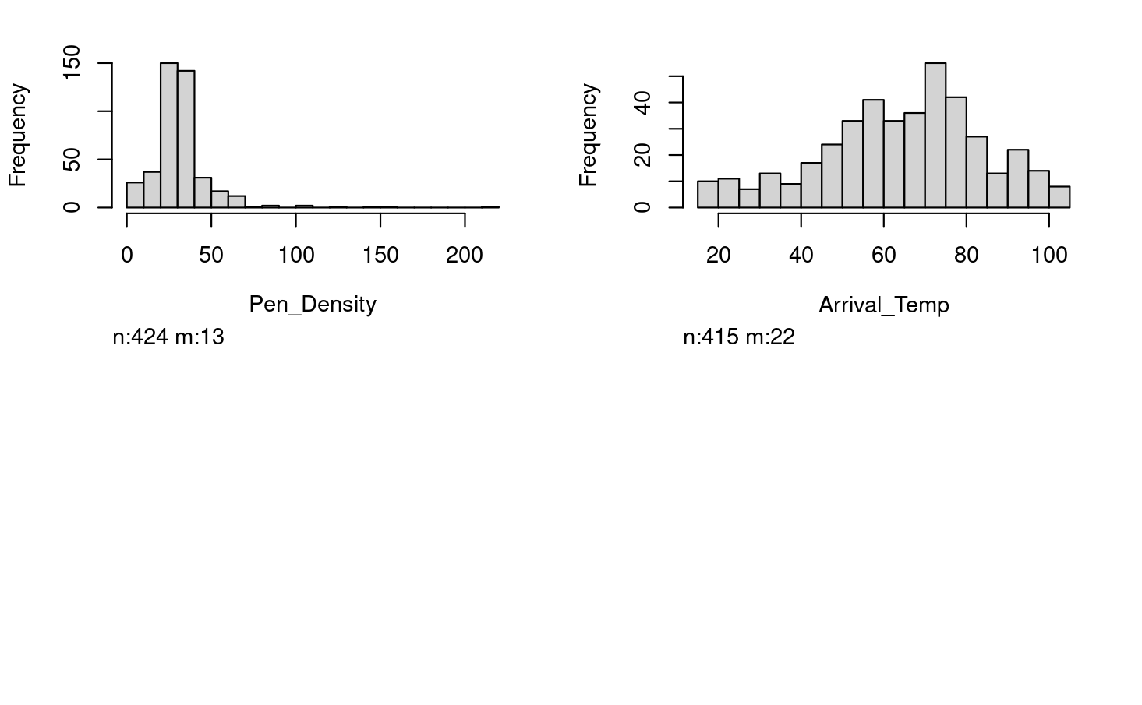
Arrival Temperature Summary Statistics
Arrival Temperature
Sample Size without NA: 415
Min = 17℉
Max = 103 ℉
Median = 67 ℉
Mean = 64.71 ℉
Standard Deviation = 19.75
Variance = 389.91
1st Quartile = 52 ℉
3rd Quartile = 77 ℉

Slide 13
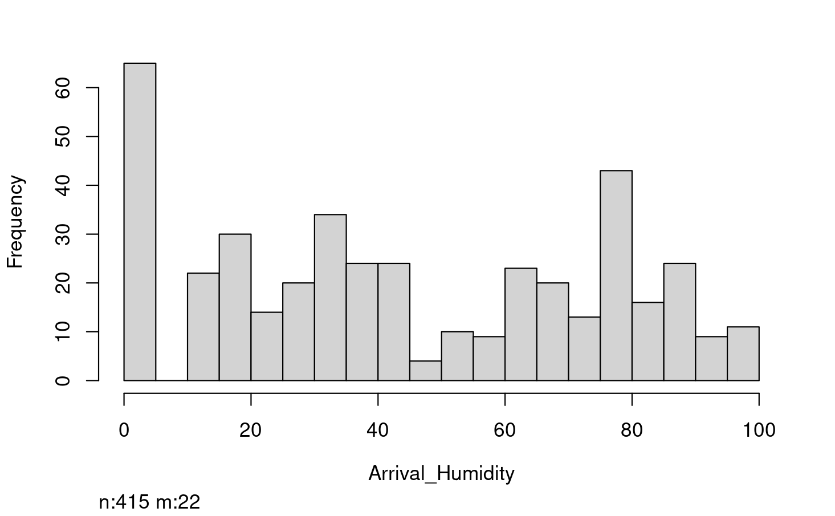
Arrival Humidity Summary Statistics
Arrival Humidity
Sample Size without NA: 415
Min = 0%
Max = 100%
Median = 40%
Mean = 44.65%
Standard Deviation = 30.65
Variance = 389.91
1st Quartile = 18%
3rd Quartile = 75%

Slide 14
Pen Density Statistics
Pen Density
Sample Size without NA: 424
Min = 0, error in data entry
Max = 214.55 ft^2/head
Median = 29.99 ft^2/head
Mean = 31.92 ft^2/head
Standard Deviation = 18.91
Variance = 357.86
1st Quartile = 23.74 ft^2/head
3rd Quartile = 36.48 ft^2/head

Slide 15
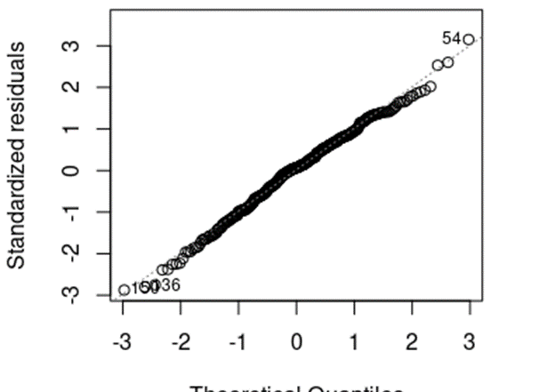
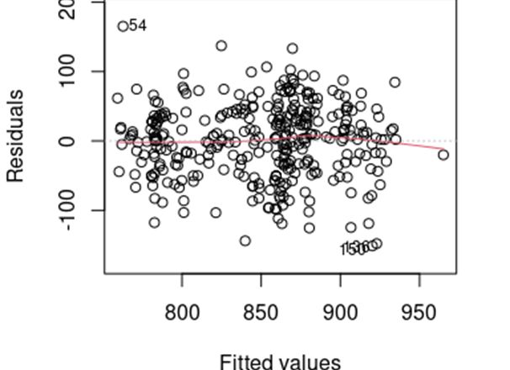
Hot Weight(Quality Outcomes) Analysis
For Hot Weight analysis we used a Multiple Regression model
437 Lots
We started with 7 variables (Sex, Plant, Kill Shift, Arrival to Unload Time, Arrival Temperature, Arrival Humidity, Pen Density)
We chose our model by using AIC and Backward elimination(For this presentation only the model chosen from AIC will be shown).
The best model chosen from AIC approach was Sex, Plant, Kill Shift, Arrival to Unload Time, Arrival Temperature, and Arrival Humidity

Slide 16

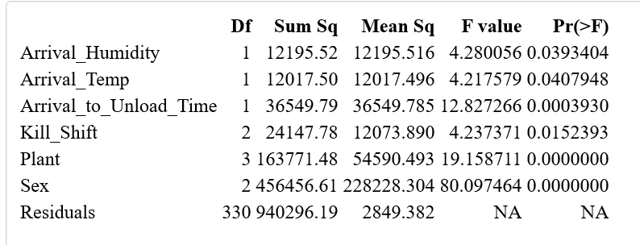
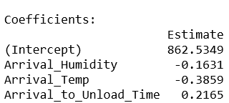
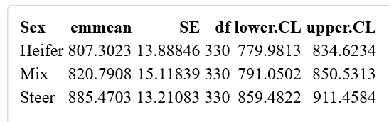
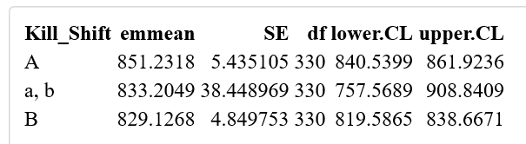
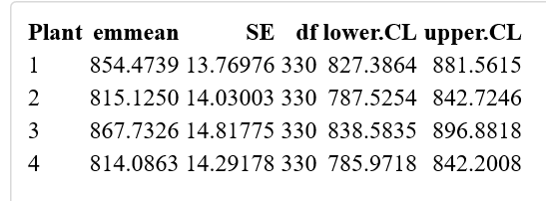
Model for Hot Weight
Anova Table and Coefficients
Emmeans for Categorical Predictors

Slide 17
Relationship between preslaughter management and welfare outcome(Was a limp detected?)
Original data was ordinal (no limp, slight limp, limp, no movement, dead/downers) but binary response (limp vs no limp) used for this analysis.
Logistic regression was used for our analysis for welfare outcomes
Used 437 Lots(144 Complete)
As before, we executed model selection by AIC, this time all 7 previous variables were kept for analysis. (Sex, Plant, Kill Shift, Arrival to Unload Time, Arrival Temperature, Arrival Humidity, and Pen Density)

Slide 18

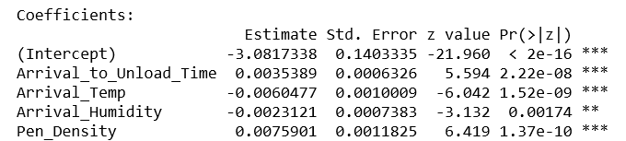
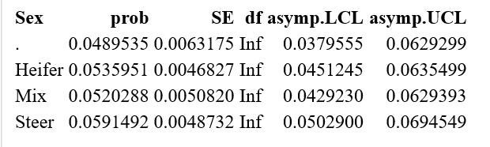
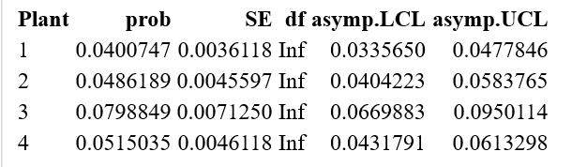
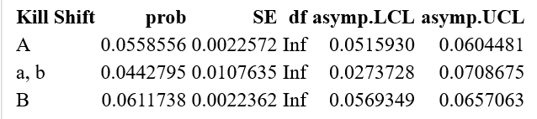

Logistic Regression Model for Limp
Note: These are not probabilities yet. We need to convert into odds-ratio by exponentiating the estimates and then calculating probability.

Slide 19
Conclusions/Enhancements
We observed that several predictors showed association for both Hot Weight and Limp (Arrival to Unload Time, Arrival Temperature, and Arrival Humidity)
In addition to statistical significance, we can also consider standard errors, correlation, effect size.
If more time permitted, our quality outcome model could be enhanced by adding an interaction between arrival temperature and arrival humidity and adding quadratic regression to our model for Hot Weight.

